Slide 1




Holos Visualization Enhancements
Leveraging AI/ML for Sustainable Agricultural Insights
Presented by: Team 8

Slide 2

Our Team
Bikky Sedhain
Raj Kiritkumar Panchal
SNS Harshinee Koka
Sunny Kiran Gangar
Susmitha Yaramashetti

Slide 3

Agenda
Introduction
Project Scope
Requirements
Workflow Overview
Implementation Approach
Results and Insights
Conclusion

Slide 4



Introduction
Holos Overview
A platform combining crop science and AI/ML for agricultural insights.
Challenge
Existing visualization tools face issues like inaccurate boundary alignments
and lack of temporal analyses.
Goal
Enhance decision-making through improved visualization tools and analytics.

Slide 5
Project Scope
Enhance GIS-based map overlays with accurate boundary alignments..
Integrate multi-variable analysis for yield, water, and nitrogen productivity.
Optimize visualization tools for stakeholder decision-making.
Embed advanced Python-based visualizations into the Holos platform.

Slide 6
Requirements
1
Overlay multiple Holos simulation outputs on a map .
2
Use free, public-domain Python packages for visualization.
3
Ensure compatibility with existing data structures (e.g., pandas).
4
Remove sub-block boundaries for cleaner visualization.
5
Achieve alignment with district-level boundaries on maps.
6
Enable overlaying different simulation outputs (e.g., yield, water productivity, nitrogen productivity) for composite analysis.

Slide 7
Workflow Overview
Data Analysis: Verified missing values and checked for duplicates.
Development Environment Setup: Installed required libraries.
Function Implementation: Developed functions to generate the map.

Slide 8
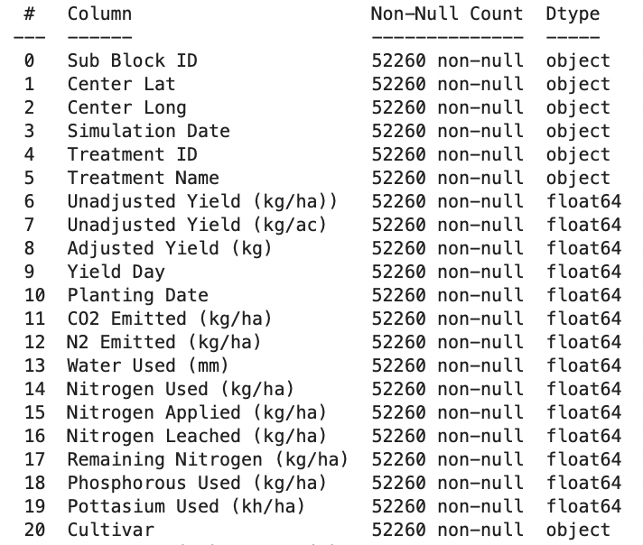
Data Description
DATA SET #1
DATA SET #2
Dataset Overview
Total Entries: 52,260records
Columns: 21 features
Shapley file that contained district geometry for Tamil Naidu.
DATA SET #3
GeoJson file consisted of longitude and latitude information required to render the map.
Yield-specific data include yield in kg/ha, nitrogen used kg/ha, water used, etc.

Slide 9
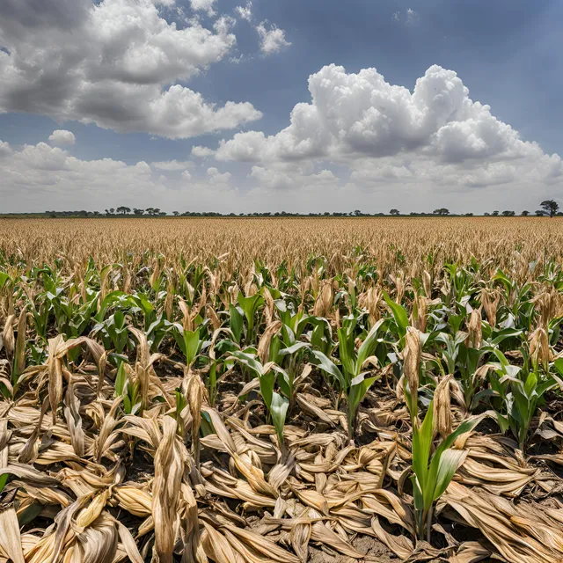
District level yield visualization
Generated three different sets of Maps:
The first map displays the average yield per district..
Second map provides information on average yield rank per district..
Third map enables to view variety of yields per district on top of the average yield.

Slide 10
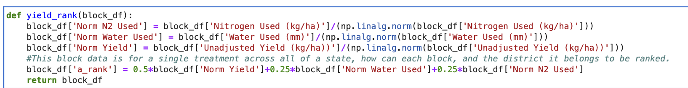
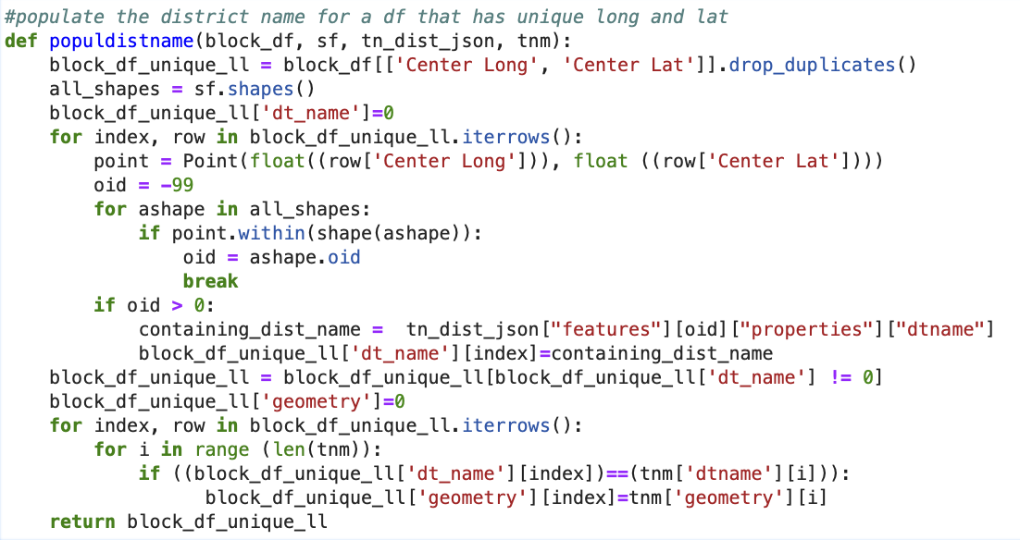
Implementation Approach
yield_rank(..) function normalizes water used, nitrogen used & yield, and calculate rank for each observation.
populdistname(..) function populates the district name and geometry in data with unique set of longitude and latitude.

Slide 11
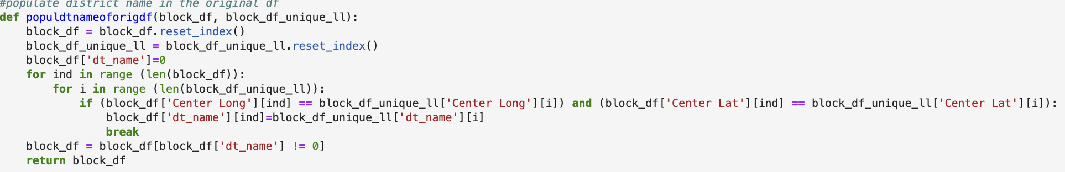
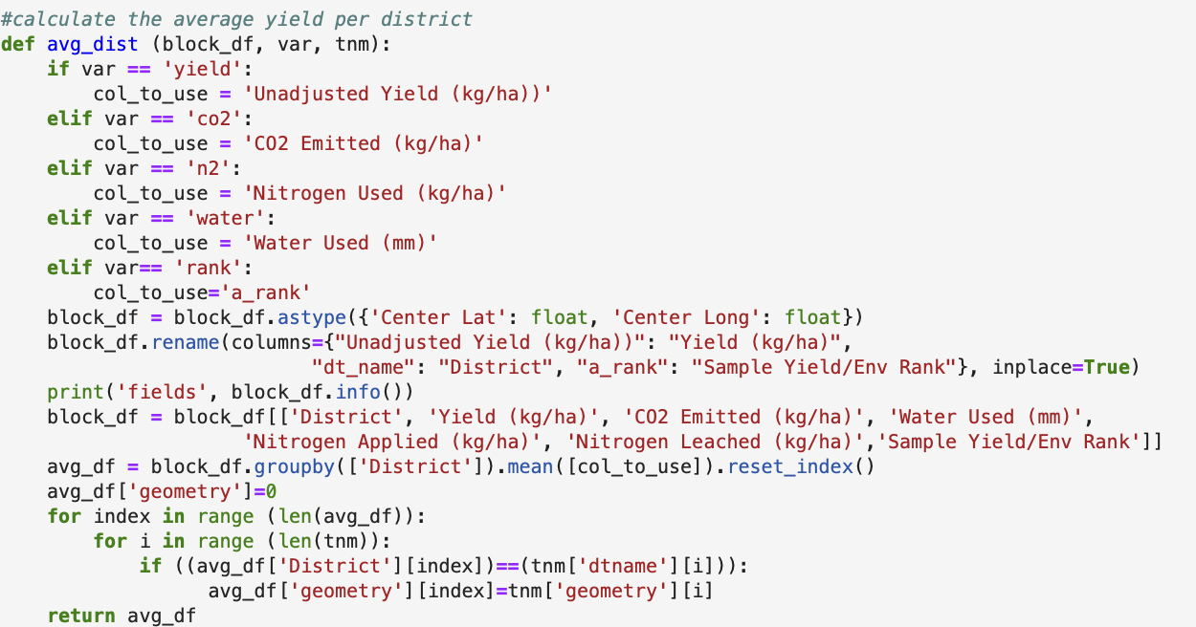
populdtnamefororigdf(..) function populates district name in orginal dataset.
avg_dist(..) function provides the average yield per district, and also populates geometry field in the averaged dataset.

Slide 12
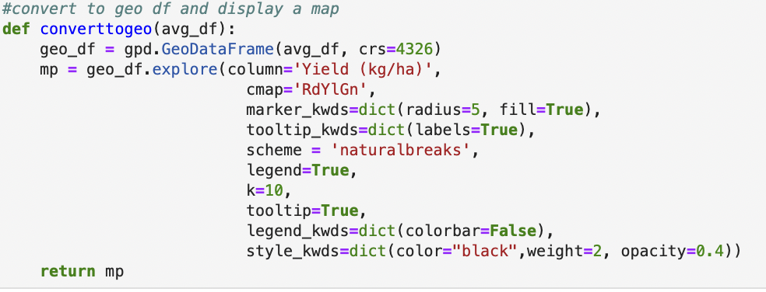
converttogeo(..) converts pandas dataframe to geo dataframe, and reders a map

Slide 13
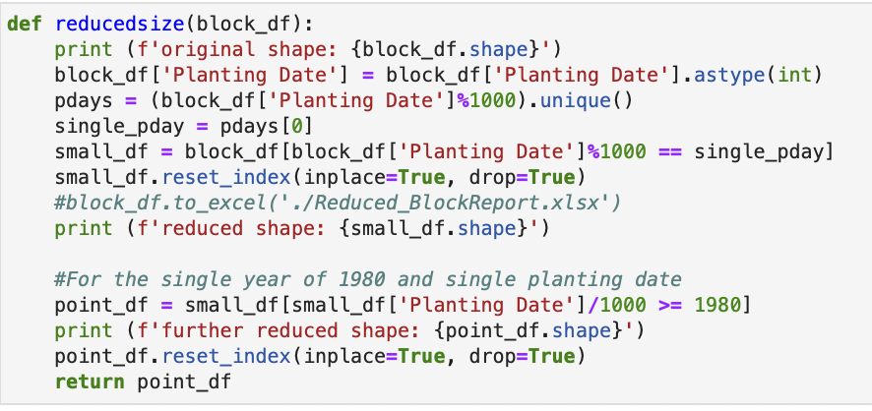
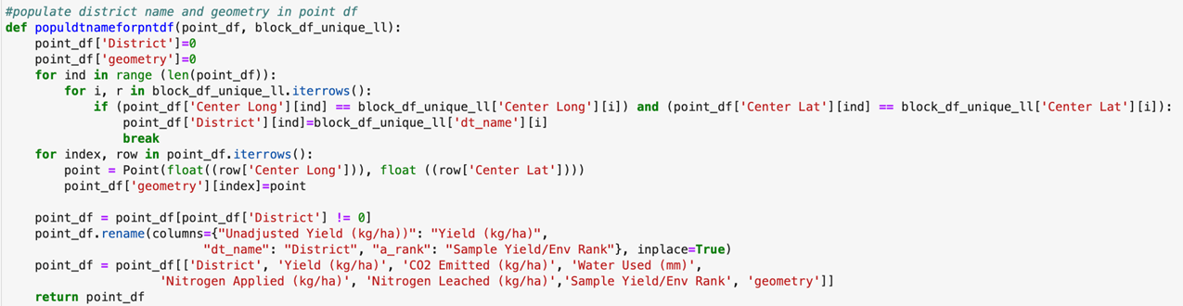
reducedsize(..) function slices the original data and provides the smaller set
populatedtnameforpntdf(..) function populates district name for smaller dataset, and also populate geometry as points.

Slide 14
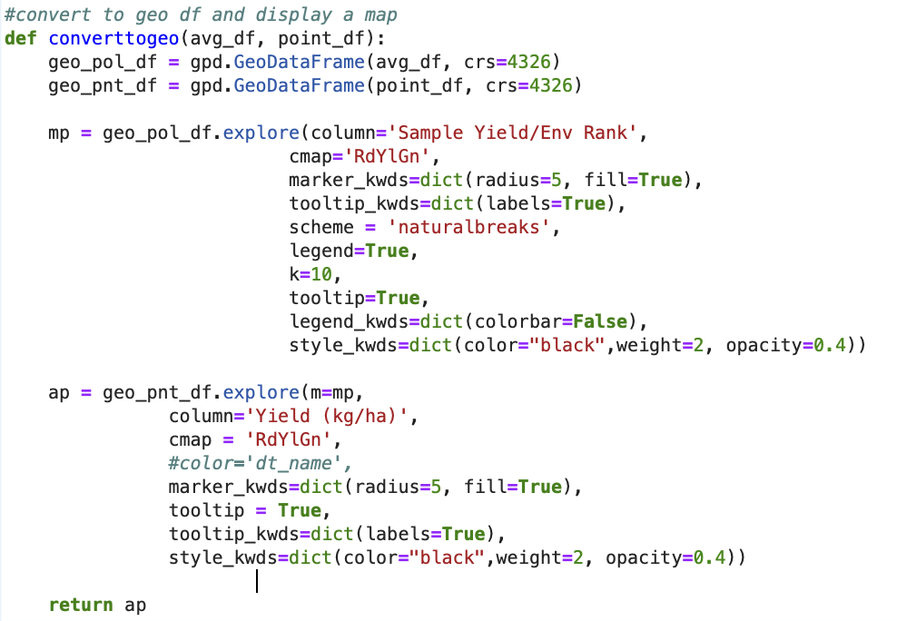
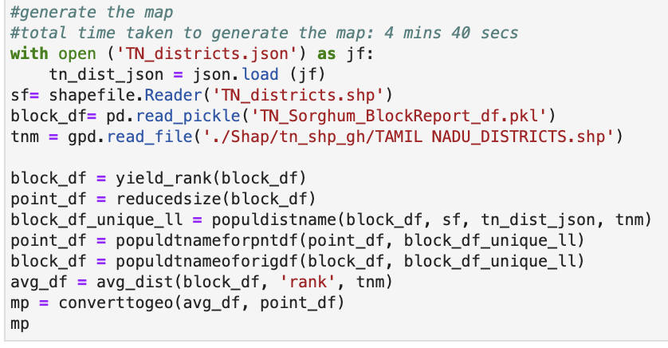
converttogeo(..) function converts pandas data into geo data, and renders the map.
Functions for rendering Map
Total time taken to generate Map: 4 mins 30 secs

Slide 15
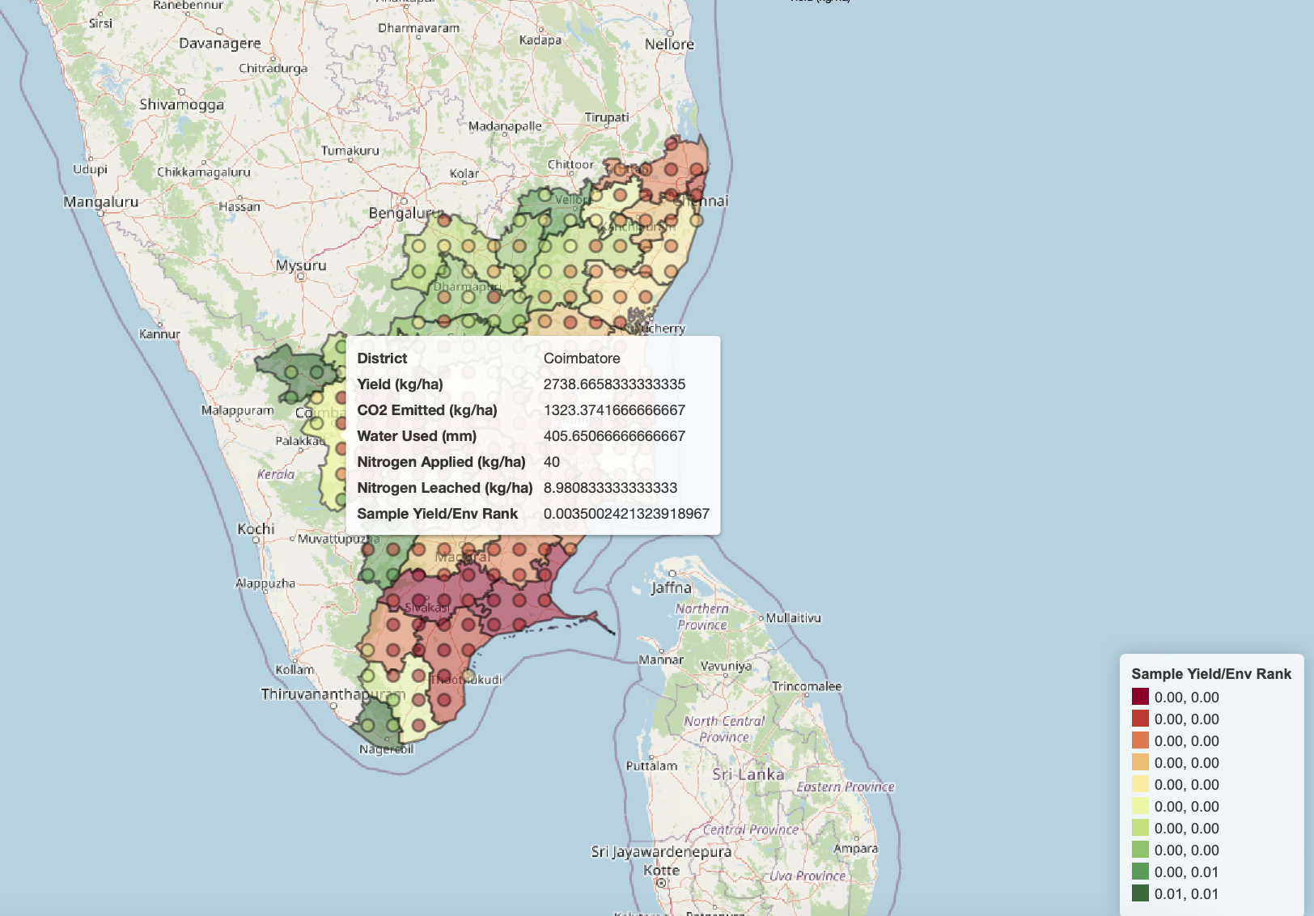
Rendered map

Slide 16
Three Distinct types
Multi layer map with yield points
Average yield rank per district
Average yield per district

Slide 17
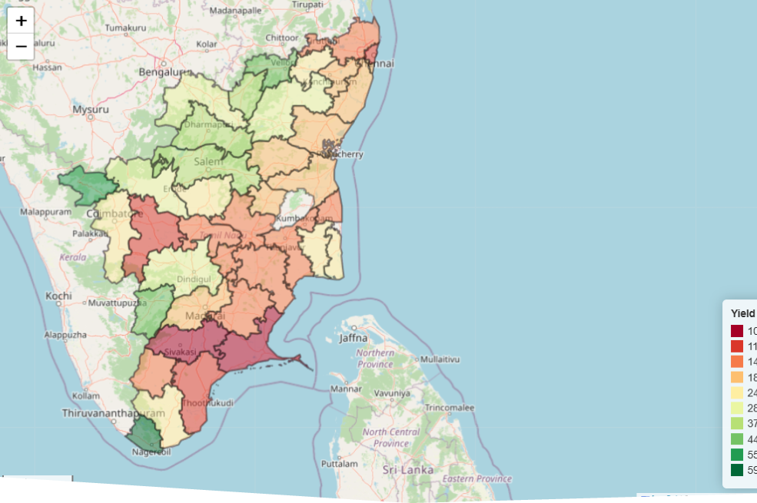
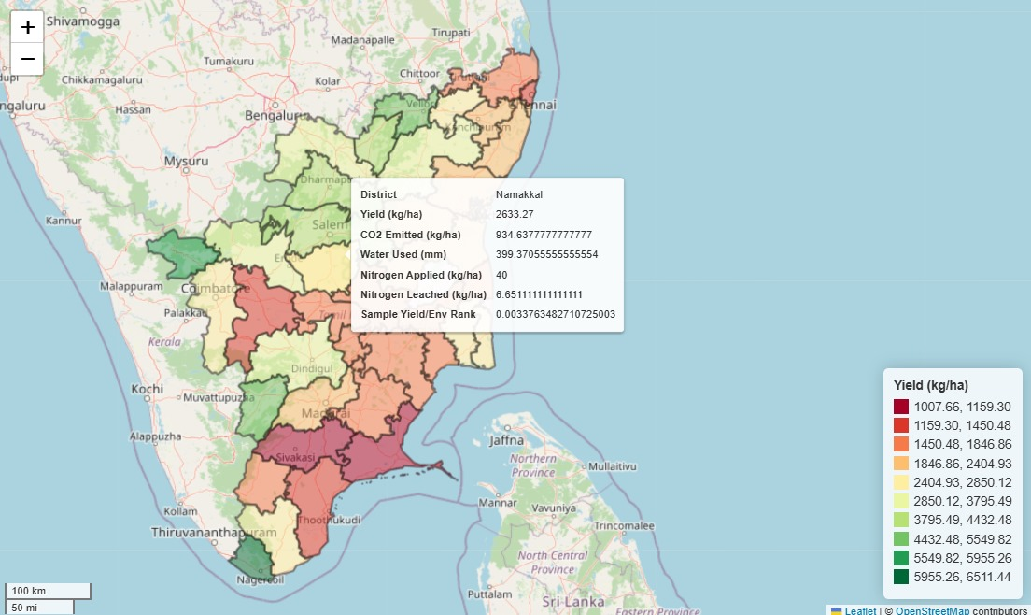
Average yield per district

Slide 18
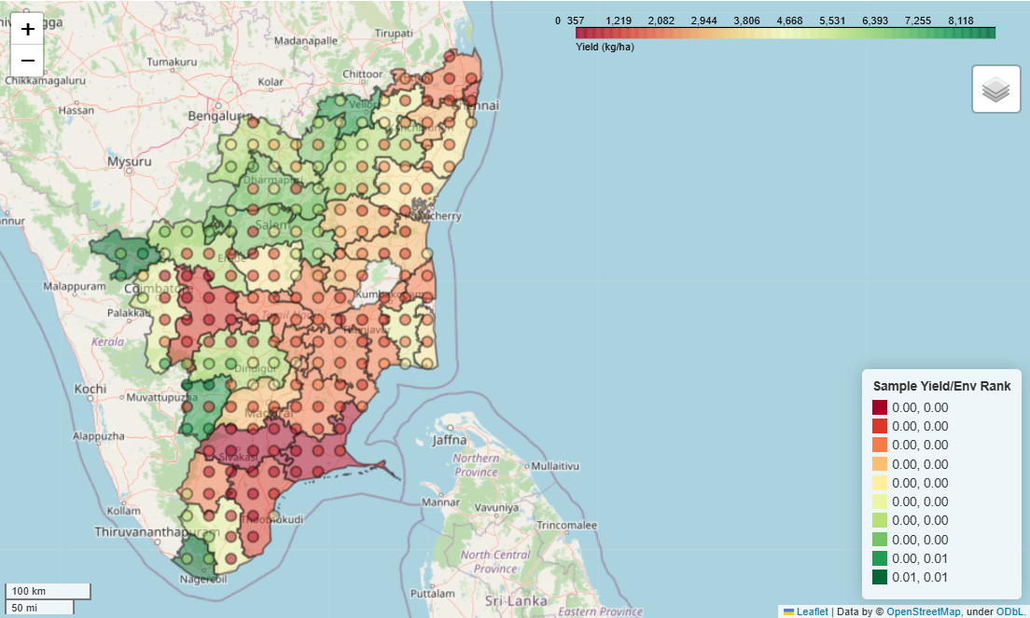
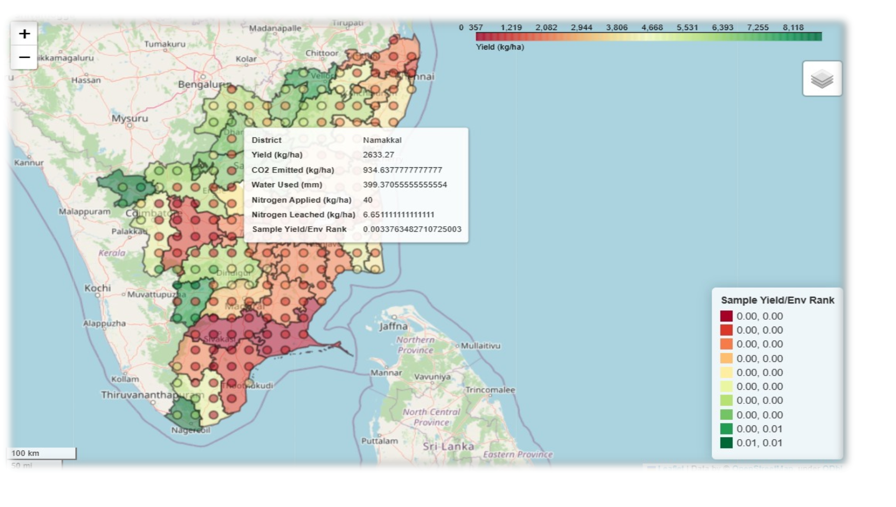
Multi Layer

Slide 19
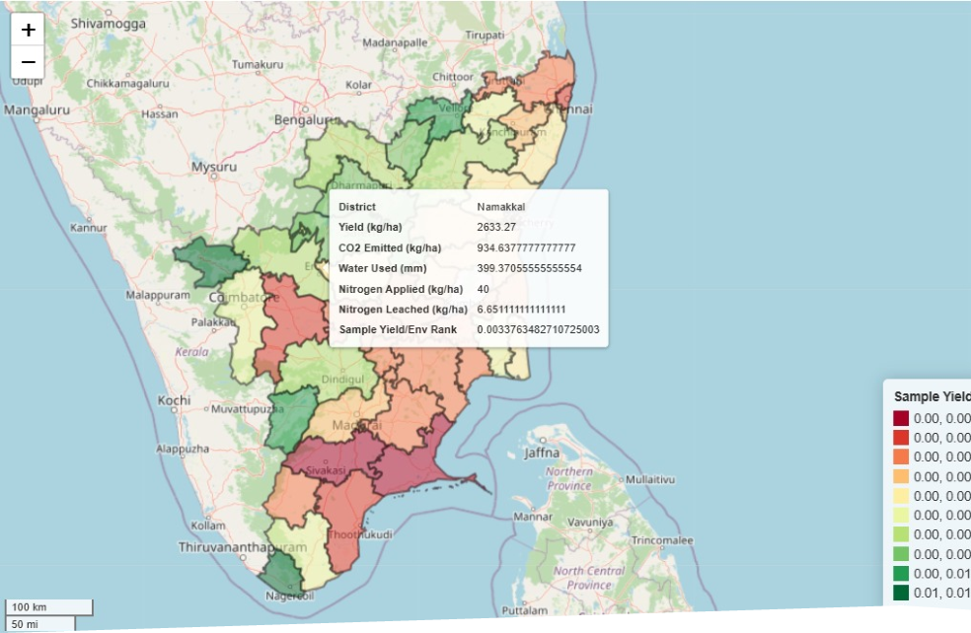
Yield rank per district

Slide 20
.
.
Conclusion
Explored GeoPandas Libraries: Researched tools for geospatial data handling
Library Installation: Set up necessary libraries for map generation
Map Rendering: Created district-level maps to visualize:
Average yield per district.
Average yield rank per district.
Multiple yields overlayed on average yield.

